Slide 1
ODE 3 – Systems of ODEs, Symplectic Integrators, and Variable Step Size Methods
AMSC/CMSC 460
Dr. Christopher Moakler

Slide 2
First Order ODEs
All of the methods we’ve looked at so far were used to solve first order differential equations.
As a reminder, a first order ODE is one where only the first derivative of the dependent variable appears.
No 2nd, 3rd, etc. derivatives appear.
Such ODEs are very common in physics and engineering applications.
Newton’s Law of Cooling
Population growth
Predator Prey modeling
A falling object subject to air resistance

Slide 3
Higher order ODEs
First order equations are great and all but…
We often want to look at higher order ODEs as well.
These sorts of equations appear frequently when looking at the motion of astronomical bodies.
Most models of moving particles subject to external forces involve second order derivatives.
Sometimes, even higher order ODEs are encountered.
One more common example comes from modeling the stress in beams.
If you’re interested in this you can google Euler–Bernoulli beam theory.
It involves a fourth order ODE.

Slide 4
How can we numerically solve these systems?
Since our methods are applicable to first order ODEs, it would be nice if we could somehow represent these higher order ODEs as first order equations.
Well, guess what!
We can!
You might remember from your Diff Eq class that we can convert a higher order ODE into a system of coupled first order ODEs.
When we do that, we can apply our methods to these coupled systems.

Slide 5
Converting a 3rd order ODE into a system of 1st ODEs Example
Let’s convert this third order differential into a system of first order ODEs
$$\overset{⃛}{y}=a{\left(\ddot{y}\right)}^{2}−\dot{y}+y\ddot{y}$$
The typical approach for an $n^{th}$ order ODE is to define $n$ new variables.
In this example we have,
$$y_{1}=y$$
$$y_{2}=\dot{y}$$
$$y_{3}=\ddot{y}$$
We can now write the original equation as a system
$${\dot{y}}_{1}=y_{2}$$
$${\dot{y}}_{2}=y_{3}$$
$${\dot{y}}_{3}=ay_{3}^{2}−y_{2}+y_{1}y_{3}$$

Slide 6
Applying Euler’s Method to a System of ODEs Example
Write the Euler Method update steps for the coupled system of equations
$${\dot{y}}_{1}=y_{2}^{2}−2y_{1}$$
$${\dot{y}}_{2}=y_{1}−y_{2}−ty_{2}^{2}$$
with the initial conditions
$$y_{1}\left(0\right)=0$$
$$y_{2}\left(0\right)=1$$
We need to apply Euler’s method to each ODE in turn.
First, we need the update step for the first equation
$$w_{\left(i+1\right),1}=w_{i}^{1}+h\left({\left(w_{i,2}\right)}^{2}−2w_{i,1}\right)$$
Next, we need the update step for the second equation
$$w_{\left(i+1\right),2}=w_{i,2}+h\left(w_{i,1}−w_{i,2}−t_{i}{\left(w_{i,1}\right)}^{2}\right)$$

Slide 7
Applying Euler’s Method to a system of ODEs Example cont
With these two equations,
$$w_{\left(i+1\right),1}=w_{i}^{1}+h\left({\left(w_{i,2}\right)}^{2}−2w_{i,1}\right)$$
$$w_{\left(i+1\right),2}=w_{i,2}+h\left(w_{i,1}−w_{i,2}−t_{i}{\left(w_{i,1}\right)}^{2}\right)$$
we can update them simultaneously to solve this system.

Slide 8
Solving higher order ODEs in general
To solve an $n^{th}$ order ODE we first convert it into a system of $n$ coupled first order ODEs by making the substitution
$$y_{1}=y$$
$$y_{2}=\dot{y}$$
$$…$$
$$y_{n+1}=y^{\left(n\right)}$$
You then write down the update steps for whatever numerical ODE method you are using.
You can use Euler method, Trapezoid method, RK4, etc..
All of the first order ODEs can be updated in parallel

Slide 9
Modeling the Pendulum
The ODE modeling a pendulum of length $l$ with mass, $m$ allowed to swing through a full $360°$ is,
$$ml\ddot{y}=−mgsin\left(y\right)$$
This is a second order ODE so we need to convert it into a system of first order ODEs
$${\dot{y}}_{1}=y_{2}$$
$${\dot{y}}_{2}=−\frac{g}{l}sin⁡(y_{1})$$
When solving this numerically using something like Euler’s Method can lead to some interesting and unphysical results.

Slide 10
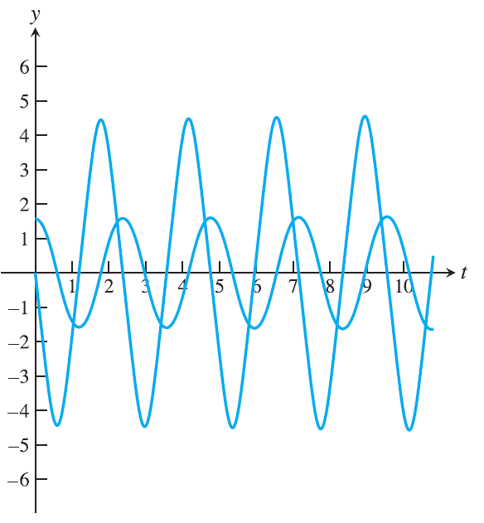
Notice anything weird here?
h = 0.01
h = 0.001
Sauer

Slide 11
Energy Conservation
The issue here is that Euler’s method is not energy conserving.
RK4 is also not energy conserving.
The problem is particularly easy to see in this example because of the periodic behavior of the system.
The pendulum should go back and forth between the left and right positions.
However, if Euler’s Method overshoots the extreme point even slightly, the system now has more energy.
The effect can quickly compound.
Using a smaller step size can minimize the problem but does not remove it.

Slide 12
Symplectic Integrators
The problem of energy conservation breaking in our ODE solvers becomes especially troublesome when we wish to model a system for long periods of time.
The longer we go, the further the energy creeps up.
We need integrators that conserve energy.
Such integrators are called symplectic integrators.
One such method is the Semi-implicit Euler Method.
The most popular one is the Velocity Verlet family of algorithms.

Slide 13
Velocity Verlet Algorithm
We typically apply the Velocity Verlet Algorithm to the position of particles in a simulation.
The ODE in questions is
$$\sum{F}=ma\left(t\right)=m\ddot{x}$$
$$f\left(t\right)=m\ddot{x}$$
here the function $f\left(t\right)$ is the interaction potential between particles.
The basic Velocity Verlet algorithm is then
$$x_{n+1}=x_{n}+v_{n}Δt+\frac{1}{2}f_{n}{\left(Δt\right)}^{2}$$
$$v_{n+1}=v_{n}+\frac{f_{n}+f_{n+1}}{2}Δt$$

Slide 14
Velocity Verlet Algorithm cont
This is typically implemented with a half step on the velocity.
Calculate $v_{n+\frac{1}{2}}=v_{n}+\frac{1}{2}f_{n}Δt$
Calculate $x_{n+1}=x_{n}+v_{n+\frac{1}{2}}Δt$
Calculate $f_{n+1}$ using the position $x_{n+1}$
Calculate $v_{n+1}=v_{n+\frac{1}{2}}+\frac{1}{2}a_{n+1}Δt$
This assumes that the interaction potential is a function only of the positions and not the velocities.

Slide 15
Energy Drift
Even these symplectic methods will have “Energy Drift” but the effect is several order of magnitudes better than non symplectic methods.
Over very long time periods, the energy will still drift.
In Molecular Dynamics fields, where these methods are often used, how much the energy drifts is one measure of the quality of a simulation.

Slide 16
Modeling Orbital Mechanics
Modeling astronomical bodies is a very very old problem.
Astronomers for thousands of years have tried to predict the motion of the stars and planets.
The problem should, in theory, be quite simple.
We just need to find the solution to coupled ODEs arising from Newton’s Second Law with a force term given by
$$F=\frac{Gm_{1}m_{2}}{r^{2}}$$
We can have any number of planets, stars, etc. in the system we wish to model.
Any number more than 2 is intractable.
Much to chagrin of astronomers.
And also the Trisolarans…

Slide 17
Modeling Orbital Mechanics cont
As we’ve said before, the ODE modeling a system with 3 interacting bodies exhibits chaotic motion.
Chaos is a fancy term for extreme dependence on initial conditions.
If the initial conditions change even slightly, we can get entirely different outcomes.
In our parlance, we would say that the solution is ill-conditioned in regard to the initial conditions.

Slide 18
Numerical Simulations of Orbital Mechanics
Due to similar reasons behind the energy drift seen before, orbital mechanics simulations exhibit non-closed orbits.
Orbits should, ideally, be closed.
The Earth orbits in a closed ellipse around the Sun.
The Moon orbits in a closed ellipse around the Earth.
There are some slight caveats here but we can safely ignore them.
This occurs because of the conservation of momentum.
Since the simple integrators we looked at before didn’t conserve the energy of the system, they also won’t conserve the momentum.

Slide 19
Euler Method applied to the one-body problem
Sauer

Slide 20
Trapezoid Method applied to the one-body problem
Sauer

Slide 21
Variable Step-Size Methods
All of the approaches we have looked at so far have used a constant step-size.
However, this is sometimes quite limiting.
Some ODEs have regions of rapid change where a very small step size might be needed.
Those same ODEs might also have regions where there is very little change and the small step size is unnecessary.
If we can vary our step size autonomously, we can get the best of both worlds!
Accurately solving the regions of rapid change and quickly solving the regions of slow change.

Slide 22
Error Estimation
Similar to our variable step size for numerical integration, we will look at the local error of the update step to determine whether we need a smaller step-size.
To do this, we need an approximation of the error at the current point.
For an FDE order $m$, we get for a single step with step size $Δt$,
$$y_{true}\left(t_{n+1}\right)=y_{approx}\left(t_{n+1},Δt\right)+A{\left(Δt\right)}^{m+1}$$
That same FDE with a step-size of $\frac{Δt}{2}$ gives us
$$y_{true}\left(t_{n+1}\right)=y_{approx}\left(t_{n+1},\frac{Δt}{2}\right)+2\left(A{\left(\frac{Δt}{2}\right)}^{m+1}\right)$$
If we subtract the two equations and solve for the error, $A{\left(Δt\right)}^{m+1}$ we get,
$$Error= A{\left(Δt\right)}^{m+1}=\frac{2^{m}}{2^{m}−1}\left(y_{n+1}\left(t_{n+1}, {Δt}/2\right)−y_{n+1}\left(t_{n+1},Δt\right)\right)$$

Slide 23
Varying the Step-Size
Now that we have an error estimate, we can use it as a criterion to decide how to change the step size.
You typically set an upper and lower bound on the error.
If your error is too large, you halve the step size.
This allows us to maintain accuracy when needed.
If your error is too small, you double the step size.
This allows us to quickly move along and not waste time where it isn’t needed.
This requires much more computational effort.

Slide 24
Embedded Pairs
Instead of simply doubling our computational effort as the previous method did, we can be more careful in how we estimate the error.
One such method uses pairs of Rung-Kutta methods, one of order $m$ and one of order $m+1$.
These pairs are chosen carefully so that the amount of extra computation needed to calculate both is minimized.
We then use the two methods to approximate the error at the current step and decide whether a halving or doubling is needed.

Slide 25
RK23
One such approach uses Runge-Kutta methods of order 2 and 3.
The 2nd order method is the explicit trapezoid method and it is paired with a 3rd order Runge-Kutta method.
The two update steps are
$$w_{i+1}=w_{i}+h\frac{k_{1}+k_{2}}{2}$$
$$z_{i+1}=w_{i}+h\frac{k_{1}+4k_{3}+k_{2}}{6}$$
with
$$k_{1}=f(t_{i},w_{i})$$
$$k_{2}=f\left(t_{i}+h,w_{i}+hk_{1}\right)$$
$$k_{3}=f\left(t_{i}+\frac{h}{2},w_{i}+\frac{h}{2}\frac{k_{1}+k_{2}}{2}\right)$$

Slide 26
RK23 cont
The error can be estimated from these two methods by
$$Error≈\left|z_{i+1}−w_{i+1}\right|=h\left|\frac{k_{1}−2k_{3}+k_{2}}{3}\right|$$
We can now use this with a pair of upper and lower bounds on the error to implement a variable step-size method.
This implementation only required one additional evaluation of $f$ compared to the standard trapezoid method.
Since we already have the terms we need to update with the 3rd order method, we can do so.
This is called local extrapolation.

Slide 27
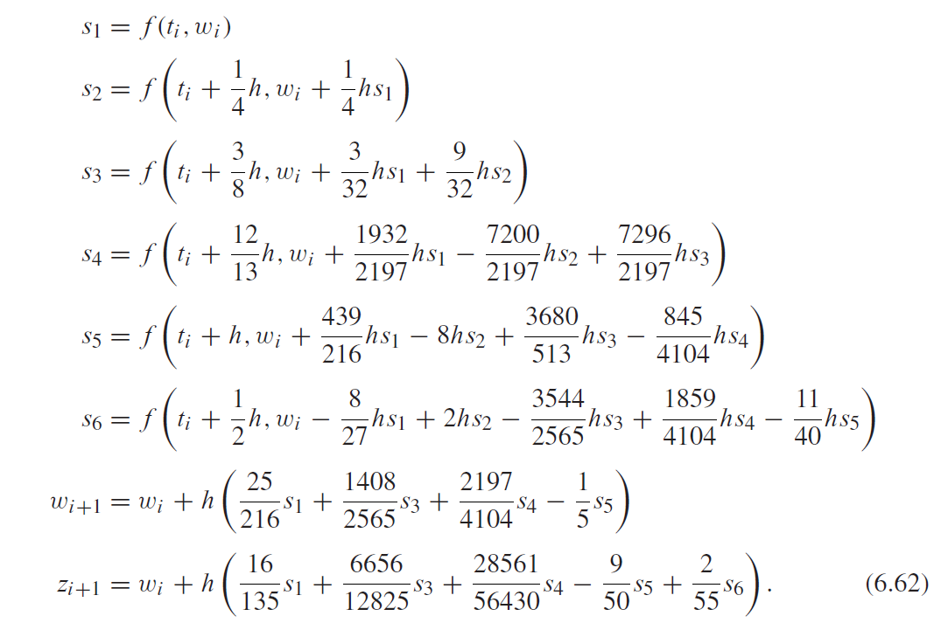
RK45
A very popular choice for the embedded pair are Runge-Kutta methods of order 4 and 5.
This is sometimes called the Runge-Kutta-Fehlberg method.
It uses six function evaluations.
Sauer

Slide 28
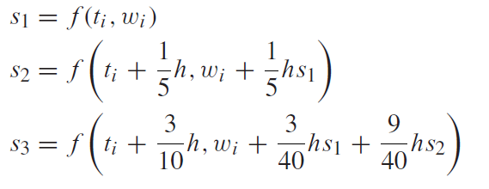
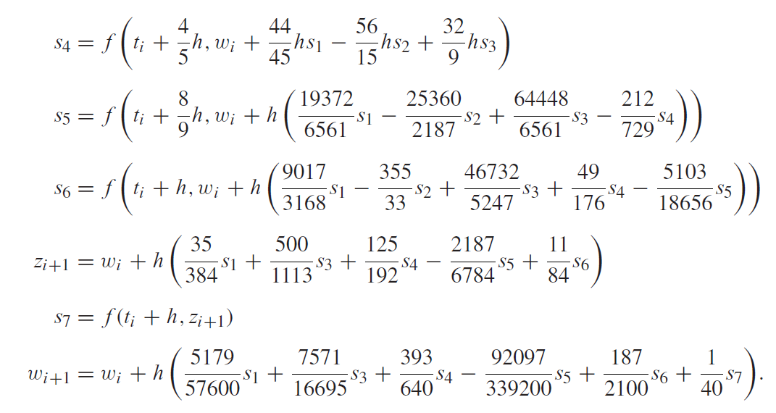
Dormand-Prince 4/5
Another choice of embedded pair is the Dormand-Prince 45 method.
Sauer

Slide 29
Dormand-Prince 4/5 cont
Dormand-Prince 45 is particularly useful because the value of $s_{7}$ can be used for $s_{1}$ in the next update step.
In this way we can use all evaluations of the function and not waste any.
Since $s_{7}$ becomes $s_{1}$ in the next step, this is a First Same As Last method.
FSAL for short.
This is what Matlab uses in its built in ode45 function.

Slide 30
Variable Step-Size example
Mathworks

Slide 31
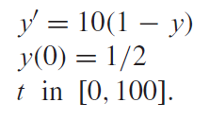
Variable Step-Size Example 2
Sauer

